Slide 1

Air Canvas
Team Python thinkers
Anto Francis (C0825095)
Omer Volkan Guney (C0831373)
Rupesh Chandran (C0826779)
Sachin Sreekumar (C0825096)
Submission: 23rd April 2022

Slide 2
Agenda
Introduction
Tools Required
Work flow
Modules
Challenges faced
Demo
Limitation
Future Work
Conclusion
References

Slide 3
Introduction

Slide 4

AIR Canvas
Air canvas is a motion-to-sketch converter that allows us to draw on screen without directly interacting with the system.
Accomplished with the help of a simple colored cap fitted on our finger.
We are using the computer vision techniques of OpenCV to build this project.
The preferred language is python due to its exclusive libraries and easy-to-use syntax.
We aim to provide a natural human-system interaction so that it does not require a keypad, pen or glove, etc., for character input.

Slide 5
main Features
It can track any specific-colored pointer
User can draw in four different colors and even change them without hassle.
Able to clean the board with a single location at the top of the screen.
No need to touch the computer once the program is run

Slide 6
Tools Required

Slide 7





Tools USED
Github (Tortoise Git)
Slack
Jira
Python IDE(pycharm)

Slide 8

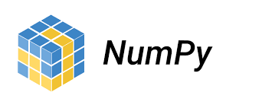
Python Library

Slide 9
Work Flow
Canvas Creation
Track Bar Setup
Adjust the trackbar values to locate the colored marker's mask.
Color Detection
Begin by reading the frames and converting them to HSV color space
Mask Creation
Using morphological techniques: Dilation and erosive erosion
Contour Detection
Detect the contours, locate the center coordinates of the most significant shape, and store them in the array for subsequent frames.
Creation of canvas and ink buttons in the web cam layout.
Drawing on Canvas
Draw the points saved in an array on the frames and canvas using drawing functions

Slide 10
Modules

Slide 11
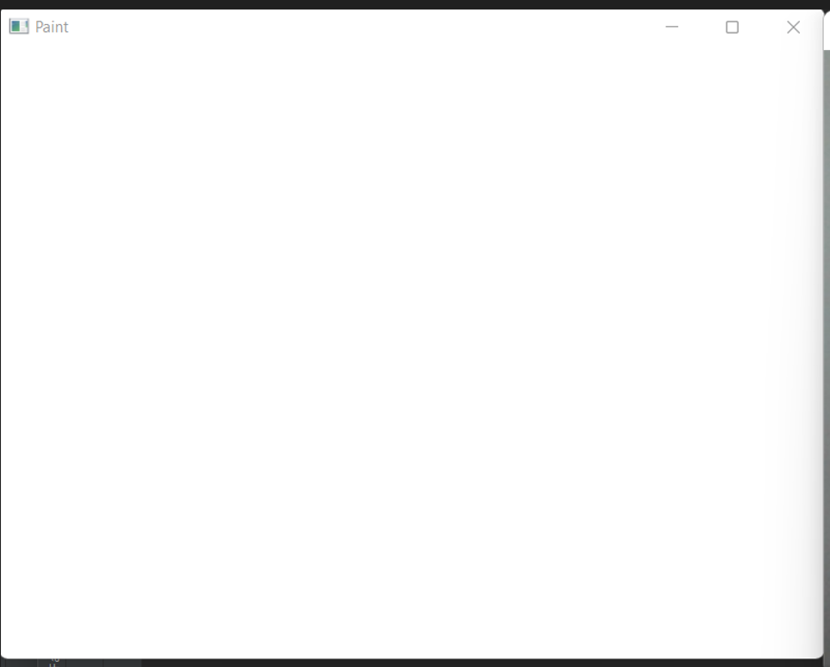
Canvas creation
Canvas refers to the workspace where the input is accounted for.
Assigned individual tasks and decided the duration of each task
We coded a resolution workspace of 471x636 pixels with three color stages, making it a 3-layer matrix.
Implemented the window np. zeroes function

Slide 12
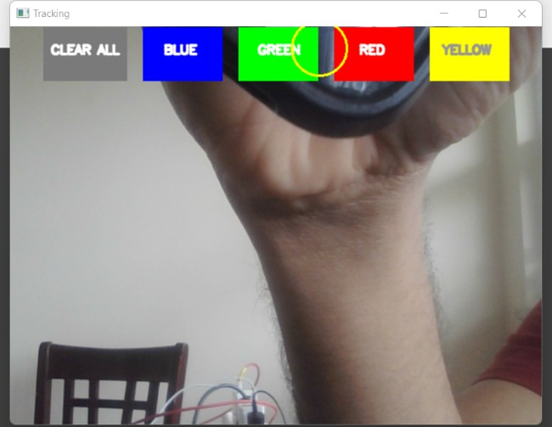
color buttons
Mainly 5 buttons: clear all, blue, green, red, yellow.
Clear all buttons to erase all the drawings on the canvas.
Hovering on the top of the color button changes the drawings’ color.

Slide 13
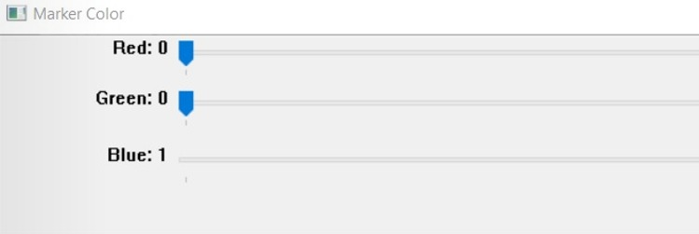
Trackbar creation
Trackbar is created to set the color to be detected.
createTrackbar function is used to create, and setTrackbarPos is used to set the values.

Slide 14
Color Detection
To detect the colored object at the tip of the finger, the incoming image from the webcam is first transformed into the HSV color space.
RGB color space was used before, but for detecting various shades of the same color, HSV color space is the best possible solution.
In HSV color space, apart from color value, extra attributes hue and saturation identify more shades of color.

Slide 15
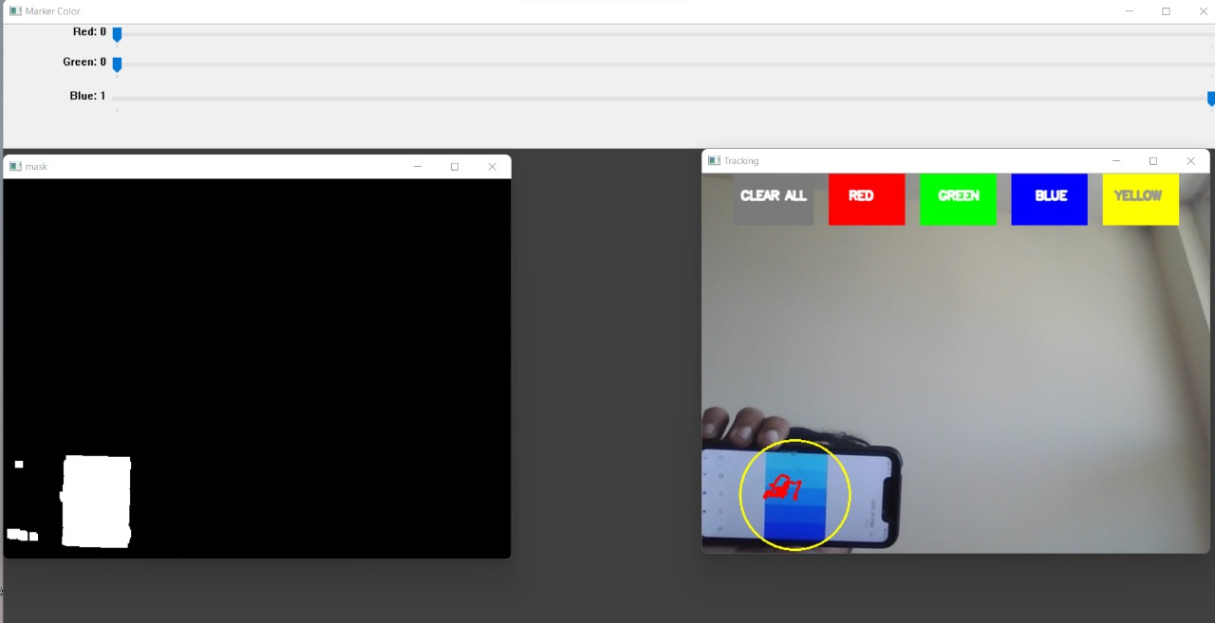
Mask Creation
Mask is a black-and-white picture with white pixels in the appropriate color locations.
Using OpenCV, the mask is created to detect the target color.
Morphological operations like dilation and erosion are performed to improve the accuracy of the color detection.

Slide 16
Contour detection
After color detection, multiple colored objects may be present, and only the thing with the highest area will be detected as the colored object.
Python has a collections library to calculate the area in OpenCV applications.
Only the center pixel or point is taken for plotting.
A data structure called deque is used for storing the central coordinates of the real-time movement of the contour

Slide 17
Drawing on Canvas
The deque will save the position of the contour on each subsequent frame, and we will utilize these points to draw a line with OpenCV drawing algorithms.
We will use the contour's position to determine whether we want to click a button or draw on the sheet. Some of the buttons have been positioned on the top of Canvas; when the pointer enters their area, their method will be triggered.

Slide 18
Challenges
Challenges
Finger-tip detection
Color detection:
Solution
Used Colored object at finger-tip
Used HSV values instead of RGB & took the object having the highest area
Inaccurate detection
Multiple colored object detection

Slide 19
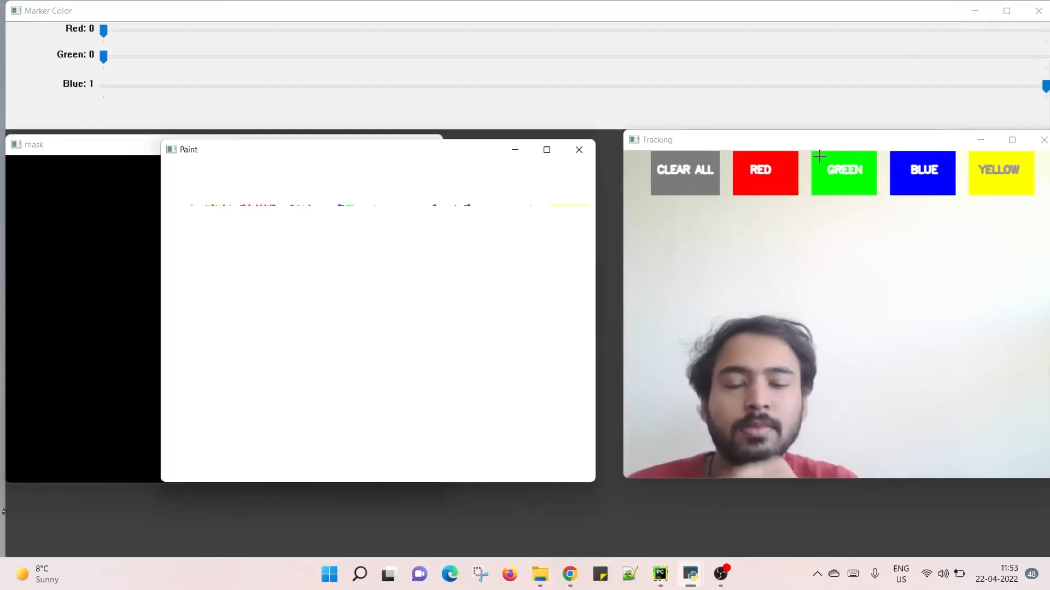
Demo

Slide 20
Limitations
Back-tracing of hand movements.
Drawing in 3D space.

Slide 21
Future Work
Eliminate back-tracing of hand movements to increase the accuracy of the drawings.
Integrating ML models to recognize text written using hand gestures.

Slide 22
Conclusion
Successfully implemented Air Canvas, enabling users to draw on a digital canvas using hand gestures.
By developing a computer vision project, python library OpenCV and functions used in the library were familiarized.
Implementing the Air Canvas project increased our knowledge base in computer vision applications.

Slide 23
References
[1] Alper Yilmaz, Omar Javed, Mubarak Shah, "Object Tracking: A Survey,” ACM Computer Survey. Vol. 38, Issue. 4, Article 13, Pp. 1-45, 2006
[2] Yuan-Hsiang Chang, Chen-Ming Chang, "Automatic Hand-Pose Trajectory Tracking System Using Video Sequences,” INTECH, pp. 132- 152, Croatia, 2010
[3] Ayushman Dashz, Amit Sahuz, Rajveer Shringiz, John Gamboax Muhammad Zeshan Afzal, Muhammad Imran Malik, Sheraz Ahmed and Andreas Dengely” AirScript Creating Documents in Air” 14th IAPR International Conference on Document Analysis and Recognition (ICDAR) IEEEXplore2017
[4] Air-writing Recognition, Part 2: Detection and Recognition of Writing Activity in Continuous Stream of Motion Data Mingyu Chen, Ghassan AlRegib, Senior Member, IEEE, and Biing Hwang Juang, Fellow, IEEE.IEEE TRANSACTIONS ON HUMAN-MACHINE SYSTEMS.
[5] A Novel Human-3DTV Interaction System Based on Free Hand Gestures and a Touch-Based Virtual Interface by SHUN ZHANG AND SHI ZHOU ZHANG IEEE Sensors J., vol. 19, no.20, pp. 95049511, Oct. 2019.

Slide 24

Thank you

